Slide 1
Writing better cases by deconstructing the case review process
by Paul W. Beamish
Ivey Business School
Western University December, 2024

Slide 2
RELEVANT EXPERIENCE
Have taught with cases and written cases for > 40 years
> 4.5 million copies of my cases have been studied
22 of my cases have won awards. To date, 16 have been best sellers at Harvard
Have reviewed > 2,000 cases
Served as executive director of Ivey Publishing for 16 years.

Slide 3
DECONSTRUCT
“To analyze or examine the basic parts
or elements of something, especially for discovering interrelationships”
Source: Merriam Webster Dictionary

Slide 4
Overview of the Review PROCESS
Ivey Publishing

Slide 5
Introduction to the Review Process
Purpose of Review
Collect structured feedback from expert reviewers on product submissions.
Ensure product quality and readiness for publication.
Process Overview
Reviewers receive an email invitation with the product files and a link to the Reviewer Feedback Form.
The review process is double-blind, ensuring that the identities of author(s) and reviewers are kept confidential.

Slide 6
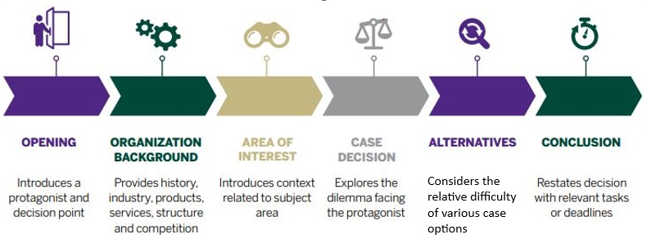
Case Elements Evaluated
Core Elements
Evaluation Process
Reviewers respond Yes/No to whether each element meets these standards.
“No” responses prompt further explanation to provide constructive feedback on the specific section.

Slide 7
Key Questions - Case Content
Case Structure
Opening:
Does it effectively engage and set the stage for the case?
Organizational Background: Is there sufficient context for students to understand the setting?
Area of Interest:
Is the main focus or challenge clear?
Decision and Alternatives
Case Decision:
Is the decision point well-articulated to foster analysis?
Alternatives:
Are feasible options presented for discussion?
Conclusion
Does the case offer a well-rounded conclusion related to the decision point?
These components ensure the case content is complete and logical, facilitating critical thinking.

Slide 8
Key Questions – Case Content (Continued)
Question #1
Does the case contain the information needed for the students to effectively address the issue that has been presented?
Question #2
Does the case contain any obvious errors (not including spelling and grammar)?
Question #3
Any additional feedback related to the case content?
Note:
The relevant feedback and comments will be relayed to the author(s) by their Product Coordinator.

Slide 9
Teaching Note Elements Evaluated
Teaching Note Components | Content
Synopsis | A brief summary (1-2 paragraphs) of the case.
Learning Objectives | 3-5 objectives outlining what students should achieve after working through the case.
Position in Course | Suggested courses (maximum of 3) and academic levels appropriate for the case.
Relevant Readings | 3-5 readings such as textbook chapters, journal articles, or practitioner sources.
Supplementary Materials | A curated list of free-to-use YouTube or other videos related to the company, the protagonist, the industry, or the case theme.
Assignment Questions | 4-6 questions, including at least one decision-based question that aligns with the case’s main decision point.
Teaching Plan | Overview of class length with a table for time allocation on the introduction, conclusion, and questions.
Analysis | In-depth (3-5 pages) answers to the assignment questions.
What Happened | A brief follow-up on the decision made and outcomes for involved parties.
Evaluation Process
Reviewers respond Yes/No to whether each element meets the requirements for publication.
“No” responses prompt further explanation to provide constructive feedback on the specific section.

Slide 10
Key Questions –
Teaching Note and Additional Sections
Question #1
Are the teaching note exhibits appropriate and complete?
Question #2
Does the teaching note contain any obvious errors (not including spelling and grammar)?
Question #3
What do you recommend as the target audience for this material?
Choose an option from a dropdown list that includes “Introductory”, “Introductory/Undergraduate”, “Undergraduate”, “Undergraduate/MBA”, and “MBA/MSc/EMBA”.
Note:
The relevant feedback and comments will be relayed to the author(s) by their Product Coordinator.

Slide 11
Key Questions –
Teaching Note and Additional Sections (Continued)
Additional Feedback Areas
Additional comments on the teaching note content:
The relevant feedback and comments will be relayed to the author(s) by their Product Coordinator.
Evaluation Process
Reviewers respond Yes/No to whether each element meets these standards.
“No” responses prompt further explanation to provide constructive feedback on the specific section.

Slide 12
Final Sections & Reviewer Preferences
Reviewer Likelihood to Use Material
Scale from 1 (Unlikely) to 5 (Definitely) on whether the reviewers would recommend or use the material in their classrooms.
Estimate time (in hours) spent on the review.
Option to receive notification when the product is published.
Other Details
Additional Comments to Upload
Option for reviewers to upload detailed, multi-page feedback on the case and/or teaching note content beyond what fits in a text box (*Not mandatory).

