Slide 1
VALUE vs GROWTH INVESTING AND THE FUTURE OF STOCK PRICES
Presentation at the Ben Graham Centre’s 3rd European Value Investing Conference
October 13, 2023
Copyright © 2023 Dr. George Athanassakos – Not to be Copied or Transmitted Without Permission

Slide 2
George Athanassakos, PhD
Professor of Finance & Ben Graham Chair in Value Investing
Director, Ben Graham Center for Value Investing
Copyright © 2023 Dr. George Athanassakos – Not to be Copied or Transmitted Without Permission

Slide 3
Value vs Growth Investing
Outline
WHO ARE THE VALUE INVESTORS?
WHAT PROCESS DO THEY FOLLOW?
DOES VALUE INVESTING WORK?
THE FUTURE OF STOCK PRICES: VALUE VS GROWTH
Copyright © 2023 Dr. George Athanassakos – Not to be Copied or Transmitted Without Permission

Slide 4
WHO ARE THE VALUE INVESTORS?
Copyright © 2023 Dr. George Athanassakos – Not to be Copied or Transmitted Without Permission

Slide 5
Approaches to Investing
Long-Term
Fundamental Value - Bottom-Up Analysis
Market Price vs. Intrinsic Value
Short-Term
Fundamental Value - Bottom-Up Analysis
Current Price
Forecast Change
Copyright © 2023 Dr. George Athanassakos – Not to be Copied or Transmitted Without Permission

Slide 6
WHAT PROCESS DO VALUE INVESTORS FOLLOW?
Copyright © 2023 Dr. George Athanassakos – Not to be Copied or Transmitted Without Permission

Slide 7
Value Investing in Practice
Step 1: The Search Process
Look for Possibly Undervalued Stocks, Such as
Obscure and/or Undesirable Stocks
Small Cap Stocks
Low Analyst Following Stocks
Low P/E or Low M/B Stocks
Or, Companies With Sustainable Competitive Advantage
First Step, not to be Confused With Final Stock Selection
Copyright © 2023 Dr. George Athanassakos – Not to be Copied or Transmitted Without Permission

Slide 8
Value Investing in Practice
Step 2: Valuation
Value Investors Estimate Intrinsic Value by Looking at
A Company’s Balance Sheet and the Replacement Value of a Company’s Assets
The Value of a Company’s Current Earnings and Earnings Power
Only in Exceptional Cases Value Investors Factor in Growth
Copyright © 2023 Dr. George Athanassakos – Not to be Copied or Transmitted Without Permission

Slide 9
Value Investing in Practice
Step 3: Stock Selection
Know What You Know
Not All Value is Measurable
Not All Value is Measurable by You
Invest in Truly Undervalued Stocks
Look for Margin of Safety – Buy a Stock Only if its Market Price is Below an Entry Price, Where Entry Price is Equal to 2/3 of Intrinsic Value
If no Undervalued Stocks are Found, Stay in Cash
Value Investing Implies Concentration
Be Disciplined and Patient
Copyright © 2023 Dr. George Athanassakos – Not to be Copied or Transmitted Without Permission

Slide 10
DOES WHAT VALUE INVESTORS DO WORK?
Copyright © 2023 Dr. George Athanassakos – Not to be Copied or Transmitted Without Permission

Slide 11
Historical Records Confirm that Value Investing Works
Value Stocks Earn Higher Returns Than Growth Stocks
The Difference is Larger for Smaller Stocks, But Also Present in Large Stocks
The Value Premium Exists Also in Equity Markets Around the World
Copyright © 2023 Dr. George Athanassakos – Not to be Copied or Transmitted Without Permission

Slide 12
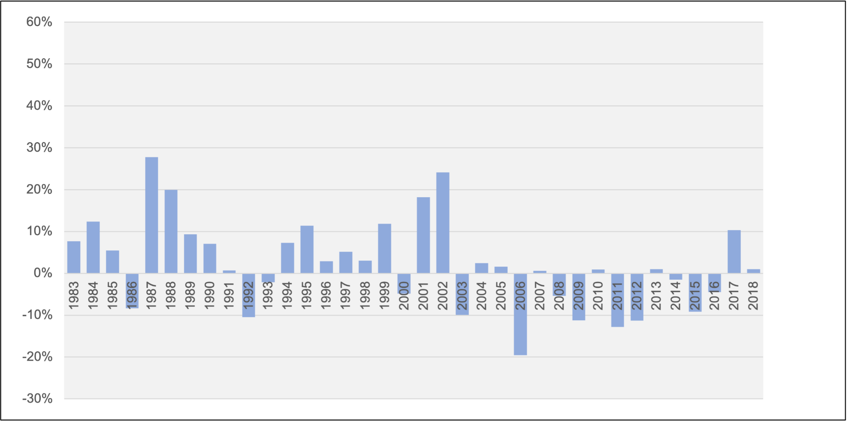
P/B-based Canadian Value Premiums by Year, 1983-2018
Copyright © 2023 Dr. George Athanassakos – Not to be Copied or Transmitted Without Permission

Slide 13
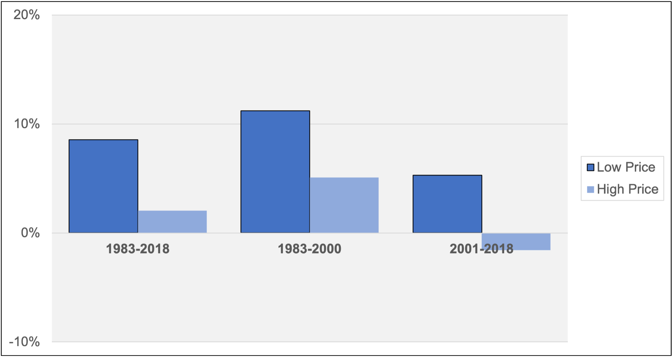
Canadian Value Premiums Based on P/B Ratio and Stock Price for 1983-2018 and Sub-Periods
Copyright © 2023 Dr. George Athanassakos – Not to be Copied or Transmitted Without Permission

Slide 14
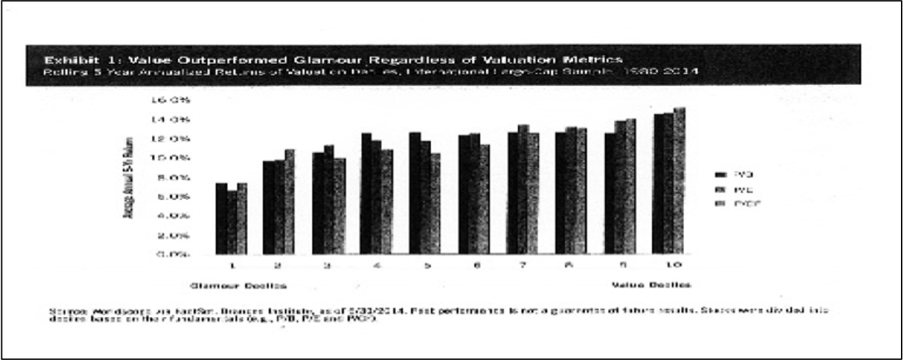
Value Investing in Global Markets: 1980-2014
Copyright © 2023 Dr. George Athanassakos – Not to be Copied or Transmitted Without Permission

Slide 15
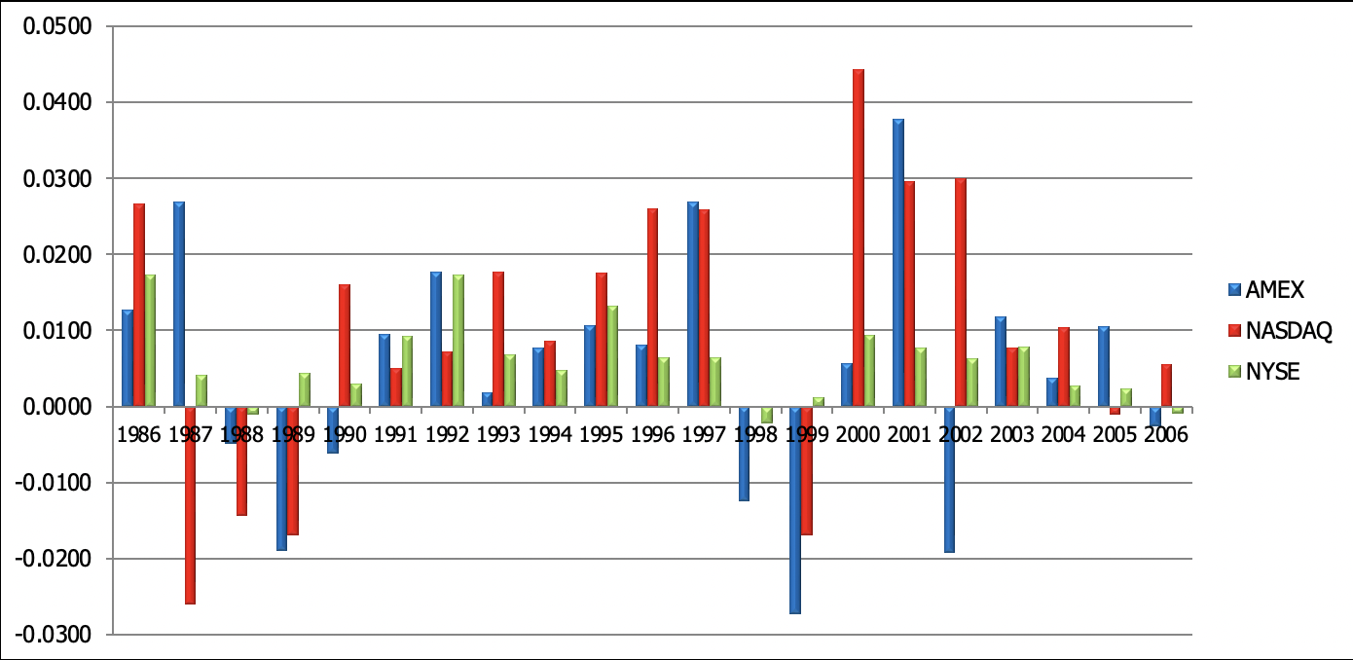
Mean Monthly U.S. Value Premiums to P/E Ratio Based Value and Growth Strategies by Year: 1986-2006
Copyright © 2023 Dr. George Athanassakos – Not to be Copied or Transmitted Without Permission

Slide 16
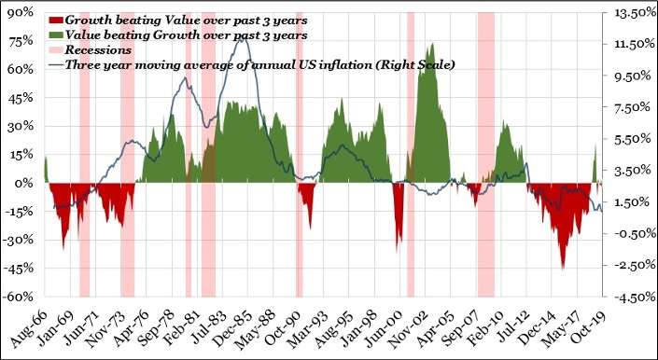
US Annualized Three-year Average Monthly P/B-based Value Premiums Against a Measure of 4 year Ahead Expected Inflation
Copyright © 2023 Dr. George Athanassakos – Not to be Copied or Transmitted Without Permission

Slide 17
Inflation and the Value Premium:
A historical Perspective
During the Cold War years between 1966 and 1991 – with U.S. inflation averaging 4.3 per cent annually – value stocks outperformed growth stocks by 10.8 per cent per annum,
Between 2008 and 2020 – when inflation averaged only 1.7 per cent – growth outperformed value by 4.2 per cent.
Over longer periods too, i.e., Between 1930 and 2020
The ten-year periods with the highest inflation were: 1940-1950, 1970-1980 and 1980-1990. The median value premiums were 7.56%, 9.96% and 13.93%, respectively.
The ten-year periods with the lowest inflation were: 1930-1940, 1950-1960 and 2010-2020. The median value premiums were -2.10%, 1.98% and -2.70%, respectively.
Copyright © 2023 Dr. George Athanassakos – Not to be Copied or Transmitted Without Permission

Slide 18
The Future of Stock Prices:
Historical Overview
The fall of the Berlin Wall, the break-up of the Soviet Union and the end of the Cold War in 1989-91 ushered in the new era of globalization. The admission of China to the World Trade Organization in 2001 completed the picture.
Globalization shrunk the world.
As a result of globalization, many citizens in the developed world were displaced by the labour force of China and India. Manufacturing jobs disappeared in developed countries at an alarming rate, and moved to developing countries.
Copyright © 2023 Dr. George Athanassakos – Not to be Copied or Transmitted Without Permission

Slide 19
The Future of Stock Prices:
Historical Overview, Cont’d
An increased pool of cheap labour from China and India drove wages down, or prevented them from rising.
Moreover, increased economic integration or openness led to weakened workers’ bargaining power.
Tax friendly government policies helped reduce corporate taxation.
Increased global trade, lower labour costs and reduced taxation helped keep inflation low and by extension interest rates and benefited bonds, and real estate, but more directly stocks.
S&P 500 profit margins rose sharply from around 6% in 2000 to close to 10% in 2019.
Stock prices and profit margins are highly correlated.
Copyright © 2023 Dr. George Athanassakos – Not to be Copied or Transmitted Without Permission

Slide 20
The Future of Stock Prices: What is Next?
The secular trend toward globalization has ended with predictable adverse (long term) effects on inflation, and interest rates, as well as on bonds, real estate and stocks.
Notice similarities with previous end-of-era periods of globalization:
A pandemic that has been likened to a war, challenges to globalization by large players such as Russia and China, and rising protectionism, economic instability, and galloping inflation.
Covid-19 has brought forth a new wave of nationalism in the world with industries moving back to their home countries as seen with Japan and the US.
Wars tend to lead to an end of, or challenges to, globalization. The events in Ukraine are auguring a new Cold War and will further challenge globalization.
Copyright © 2023 Dr. George Athanassakos – Not to be Copied or Transmitted Without Permission

Slide 21
The Future of Stock Prices: What is Next?
Cont’d
Global trade is on the decline.
The effect of China on globalization benefits is also eroding.
A recent survey of 260 global supply chain leaders by Gartner found that 33% of them had already moved or planned to move manufacturing out of China (to a higher cost environment) in the near future.
The surge of new manufacturing in North America is increasing the demand for labour, and since there are not enough workers around to fill the jobs, wages are rising at the fastest pace in four decades.
Workers and unions in this environment are regaining their lost bargaining power. Recent wage settlements support this view.
Copyright © 2023 Dr. George Athanassakos – Not to be Copied or Transmitted Without Permission

Slide 22
The Future of Stock Prices: What is Next?
Cont’d
The era of declining taxation is also over. Going forward,
Pandemic related deficits and ballooning debts will require higher taxes.
Fewer workers to support retired people will also require higher taxes.
Years of underinvestment in the oil & gas industry, heavy regulation and the ESG craze have shifted not only the oil price dynamics, but also that for all commodities.
Copyright © 2023 Dr. George Athanassakos – Not to be Copied or Transmitted Without Permission

Slide 23
The Future of Stock Prices: What is Next?
Conclusion
Profit margins will be eroded going forward. Inflation will also be higher than what prevailed in the past and so are nominal interest rates.
Nominal interest rates change not only when expected inflation changes, but also when real interest rates change.
In the long run, real interest rates are on the way up, too.
Demographic developments are pushing the real interest rate trend higher. Baby boomers have been retiring and have stopped saving; in fact, they are in their “decumulation” years, which reduces the supply of funds.
This happens in the face of increased demand for capital by corporations that need to embed innovation and new technologies into their production processes, as well as by governments that need to borrow to fund structural deficits.
To clear the demand-supply imbalance, the real interest rate trend is pushed up, not unlike what had happened in the late 1970s.
The effect of higher interest rates on stocks along with the erosion of profit margins will be predictably negative in contrast to the positive effect that lower interest rates and higher profit margins had on stocks over the last 40 years.
The outlook appears particularly unfavourable for growth stocks, which will be hurt the most by de-globalization and higher inflation/interest rates.
Growth stock underperformance will also have an adverse effect on the whole market as the share of the technology sector in market indexes has increased steeply in recent years.
This does not mean that individual stocks will not do well. Stock picking and fundamental analysis will be key to outperformance going forward.
Copyright © 2023 Dr. George Athanassakos – Not to be Copied or Transmitted Without Permission

Slide 24
The Future of Stock Prices: What is Next?
Conclusion
The effect of higher interest rates on stocks along with the erosion of profit margins will be predictably negative in contrast to the positive effect that lower interest rates and higher profit margins had on stocks over the last 30 years.
The outlook appears particularly unfavourable for growth stocks, which will be hurt the most by de-globalization and higher inflation/interest rates.
Growth stock underperformance will also have an adverse effect on the whole market as the share of the technology sector in market indexes has increased steeply in recent years.
This does not mean that individual stocks will not do well. Stock picking and fundamental analysis will be key to outperformance going forward.
Value will outperform growth.
Riding the ETF bandwagon will not work.
The effect of higher interest rates on stocks along with the erosion of profit margins will be predictably negative in contrast to the positive effect that lower interest rates and higher profit margins had on stocks over the last 40 years.
The outlook appears particularly unfavourable for growth stocks, which will be hurt the most by de-globalization and higher inflation/interest rates.
Growth stock underperformance will also have an adverse effect on the whole market as the share of the technology sector in market indexes has increased steeply in recent years.
This does not mean that individual stocks will not do well. Stock picking and fundamental analysis will be key to outperformance going forward.
Copyright © 2023 Dr. George Athanassakos – Not to be Copied or Transmitted Without Permission

Slide 25
LONDON CAMPUS
1255 Western Road
London Ontario N6G 0N1
Canada
CONTACT US
E-MAIL
gathanassakos@ivey.uwo.ca
WEBSITE
www.bengrahaminvesting.ca
Copyright © 2023 Dr. George Athanassakos – Not to be Copied or Transmitted Without Permission

